Slide 1








TDTU
MACHINE LEARNING

Slide 2




521H0493: Trần Nguyễn Duy Bảo
Team members
521H0511: Nguyễn Hoàng Phúc
521H0517: Hoàng Đình Quý Vũ

Slide 3






Table Of Content
Method of analyzing features
Linear regression method
Exercise 1
Feature selection method
Other methods
Decision Tree and Random Forest
Exercise 2
Decision Tree
Random Forest
Demo Code

Slide 4
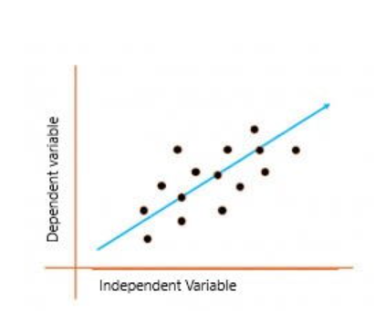
Linear regression method
Definition
Uses regression coefficients to evaluate the influence of features on prediction results.
The larger the coefficient, the more the feature affects the prediction.
06

Slide 5
Linear regression method
Types
Simple linear regression
Multiple linear regression
Logistic regression
Ordinal regression
Multinomial regression
Discriminant analysis
06

Slide 6
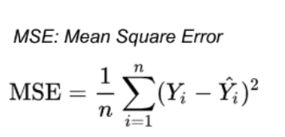
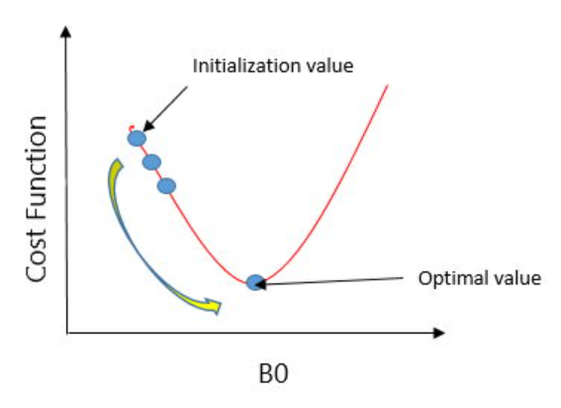
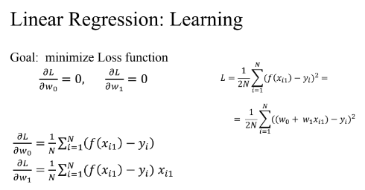
I. Linear regression method
Attention
Loss function
Gradient Descent
minimize the cost function by repeatedly updating the parameter values
Derivative formula
06

Slide 7



II. Feature selection method
Overview
Focuses on selecting the most important features -> reduce data dimensionality, improve model performance.
Training faster
Reducing the complexity
Better prediction
Reducing over-fitting
Three Method:
Filter method
Wrapper methods
Embedded methods
05

Slide 8
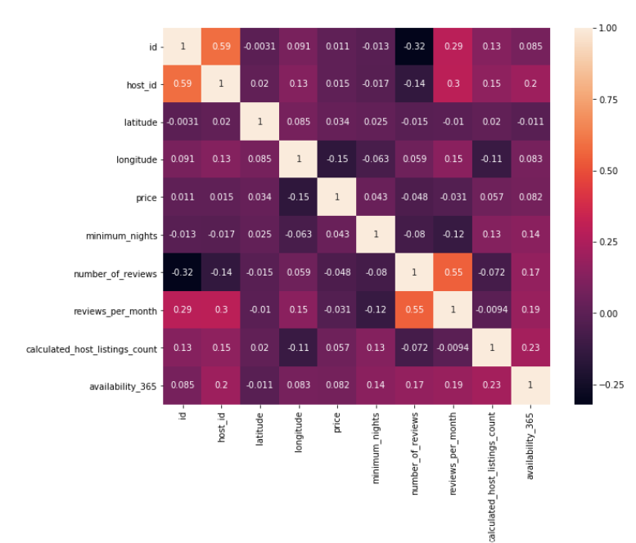

Filter
Correlation
Using the correlation between two or more variables, eliminate features with low correlation. Removing highly correlated features helps linear models perform better, avoiding bias among features.
Pearson’s correlation coefficient:
sum((x1 -x1.mean) * (x2 - x2.mean) * (xn - xn.mean)) / var(x1) * var(x2) * var(xn)

Slide 9







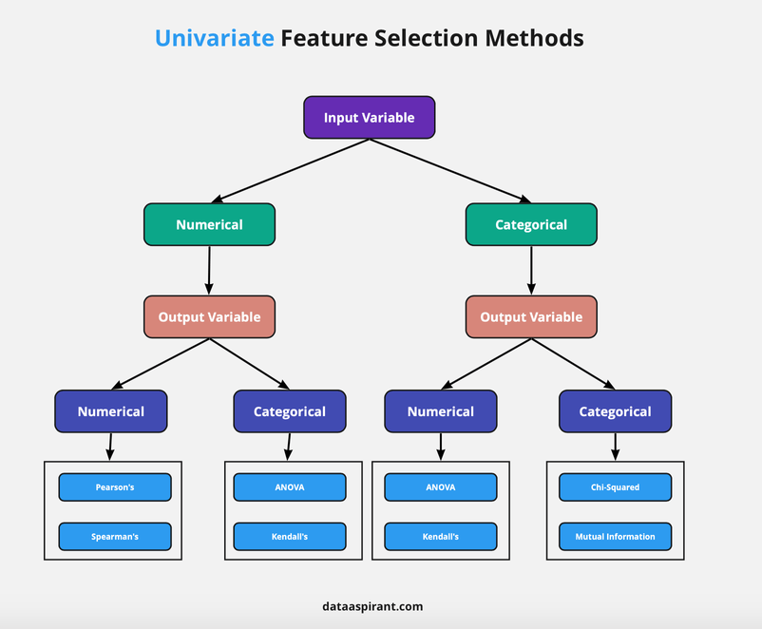
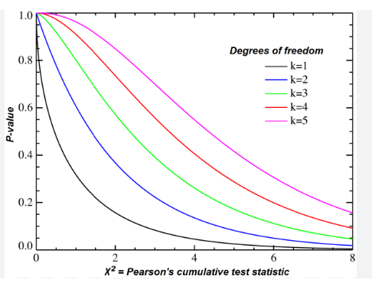
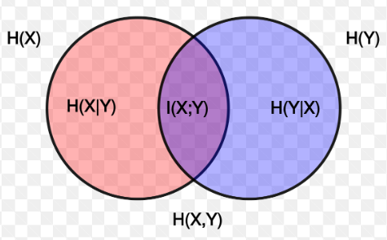
Filter
Univariate Selection
Chi-Squared Test
Mutual Information

Slide 10


II. Feature selection method
08
Backward Elimination
Wapper method
Recursive Feature Elimination (RFE)
Forward Selection

Slide 11
08
II. Feature selection method
Elastic Net
Embedded method
Lasso regression
Ridge regression

Slide 12
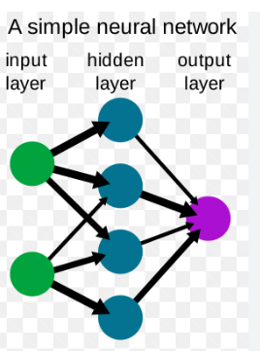

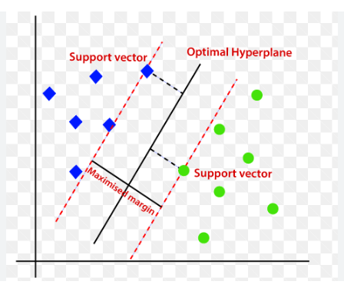
OTHER METHODS
Neural network
Support Vector Machine
Feature extraction

Slide 13
Exercise 2
Decision Tree
Random Forest
05

Slide 14
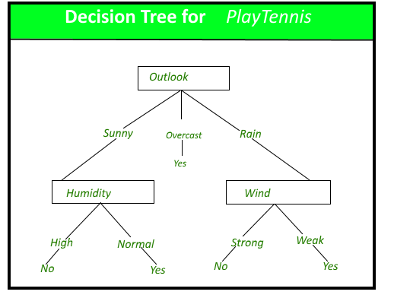
Decision Tree
Overview
a supervised algorithm that uses a tree-like model of decisions and their possible consequences, including chance event outcomes, resource costs, and ultility.
Two main node
Decision nodes
Leaf nodes
05

Slide 15
Decision Tree
Types of Decision trees
ID3 (Iterative Dichotomiser 3): leverages entropy and information gain as metrics to evaluate candidate splits.
C4.5
CART
05

Slide 16
Decision Tree
Advantages
Disadvantages
easy to interpret
little to no data preparation is required
more flexible
Prone to overfitting
High variance estimators
More costly
Not fully supported in scikit-learn
05

Slide 17
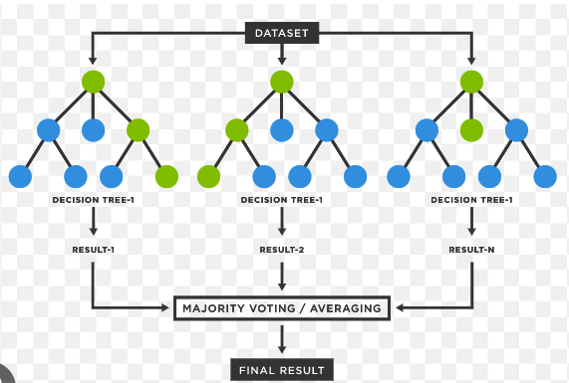
Random Forest
Overview
Combines the output of multiple decision trees to reach a single result.
Ensemble methods are made up of a set of decision trees and their predictions an aggregated.
05

Slide 18
Random Forest
Overview
Two ensemble methods: bagging and boosting.
Have three main hyperparameters before training: node size, the number of trees, and the number of features
05

Slide 19
Random Forest
Benefits
Challenges
Reduce risk of overfitting
Provides flexibility
Easy to determine feature importane
Time-consuming process
Requires more resources
More complex
05

Slide 20
Thank You
for your listening
Next , demo code

